Slide 1
KV4001 Week 6
Interfaces

Slide 2
Java interfaces
A Java interface is a set of requirements that the class must implement.
A Java interface contains:
named constant definitions.
method specifications
A Java interface does not contain:
constructors,
method bodies,
instance variables.

Slide 3
interface Definition
interface InterfaceName
{
//constant definitions
//method declarations (without implementations).
}
A method declaration is simply an access modifier, a return type, and a method signature followed by a semicolon (an abstract method).

Slide 4
Example
All methods in an interface are implicitly public and abstract, so you can omit the public modifiers.
All constant values defined in an interface are implicitly public, static, and final. Once again, you can omit these modifiers.
public interface MyInterface
{
public static final int A_CONSTANT = 32;
public static final double PI = 3.14159;
public void methodA( int x );
public double methodB();
}
Note:
constants are public,
static and final.
methods are public
and abstract.

Slide 5
implementing an interface
A class implements an interface by doing this:
public class SomeClass implements InterfaceName
{
// fields, methods and constructors
// implementation of interface methods
}
A class can only extend a single class BUT may implement several interfaces.

Slide 6
Notes
A class that implements an interface must implement all methods in the interface (or be declared abstract itself).
All methods from the interface must be declared public in the class.
Constants from the interface can be used as if they had been defined in the class.
Constants should not be redefined in the class.

Slide 7
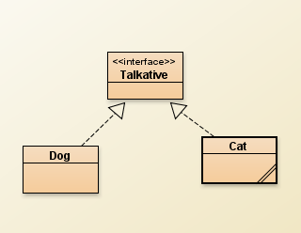
Simple Example
based on
“Designing with
Interfaces”
by Bill Venners
Create a new project
Copy the three files
Talkative.java
Dog.java
Cat.java
Compile

Slide 8
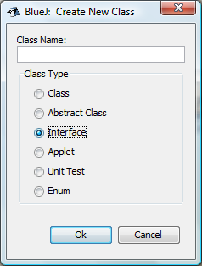
Talkative
public interface Talkative
{
public void talk();
}
BlueJ Note
To create an interface select the interface button in the create class dialogue

Slide 9
Cat / Dog
public class Cat implements Talkative
{
public void talk()
{
System.out.println("Meow");
}
}
public interface Talkative
{
public void talk();
}
public class Dog implements Talkative
{
public void talk()
{
System.out.println("Woof");
}
}

Slide 10
Interfaces are Types
An interface can be used as a data type for a reference variable.
e.g.
Talkative fido = new Dog();
Talkative kitty = new Cat();
Same considerations apply as for subclasses/superclass.
could use a Dog if type is Talkative

Slide 11
Exercise 1
Create a Dog instance and check out its talk method
Repeat for Cat
Add the following class to your project:
public class Interrogator
{
public static void makeItTalk( Talkative subject)
{
subject.talk();
}
}

Slide 12
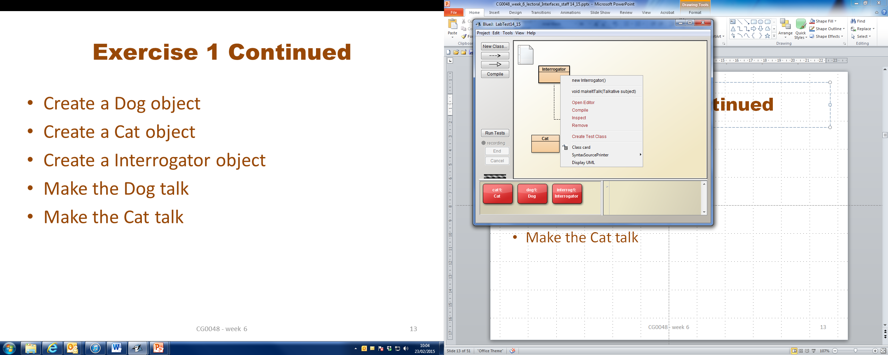
Exercise 1 Continued
Create a Dog object
Create a Cat object
Create a Interrogator object
Make the Dog talk
Make the Cat talk
Remember that the
makeItTalk method is static

Slide 13
Unrelated Classes can Implement the same interface
Create a new project: Animals and Clocks
Add the classes from Talkative
Add the class on the next slide and test the class

Slide 14
public class Clock implements Talkative
{
private boolean even = true;
public void talk()
{
if ( even)
{
System.out.println("tic");
even = false;
}
else
{
System.out.println("toc");
even = true;
}
}
}

Slide 15
Mixing Inheritance with Interfaces
Add the following class to the project and test it.
public class CuckooClock extends Clock
{
public void talk()
{
System.out.println("Cuckoo cuckoo");
}
}

Slide 16
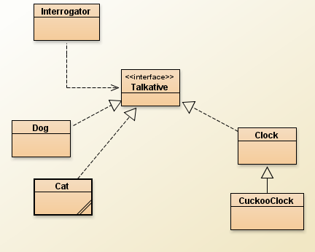
Clocks
Animals

Slide 17
Example: Shop
Let us create a database program for a shop.
The store sells:
Goods, each of which has the attributes:
description
price
The types of goods are:
Food—with an attribute "calories".
Food objects are not taxable.
Toy—with an attribute "minimumAge".
Toy objects are taxable.
Book—with an attribute "author".
Book objects are taxable.
Exercise 2
Create a new project called Shop

Slide 18
The Class Goods
public class Goods
{
private String description;
private double price;
public Goods( String des, double pr )
{
description = des;
price = pr;
}
public void display()
{
System.out.println( "item: " + description + " price: " + price );
}
public double getPrice()
{
return price;
}
}

Slide 19
Fill in the Blanks and Add Class to project
public class Food
{
private double calories;
public Food( String des, double pr, double cal)
{
super( );
calories = ;
}
public void display()
{
super ;
System.out.println( "calories: " + calories );
}
}
FILL IN
FILL IN
FILL IN
remember Food is not taxable
FILL IN

Slide 20
Taxable interface
A Taxable item,
has a taxRate of 20 percent
has a calculateTax() method.
Add the interface Taxable

Slide 21
Add Toy
Copy class from Blackboard and complete

Slide 22
Add Book
Copy class from Blackboard and complete

Slide 23
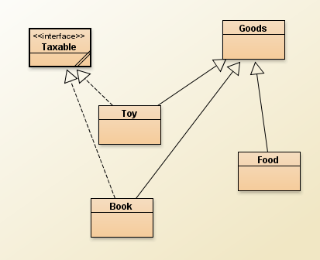
The Application

Slide 24
Exercise 3
Create the following objects:
Goods( "bubble bath", 1.40 )
Food ( "ox tails", 4.45, 1500 );
Book ( "Emma", 24.95, "Austin" );
Toy ( "Lego", 54.45, 8 );
Make sure the display methods work correctly for each
Calculate the tax where needed

Slide 25
An ArrayList of Goods
Make the Code Pad Visible
In Code Pad type the following:
import java.util.*;
ArrayList<Goods> shop;
shop = new ArrayList<Goods>()
A small red object icon will appear
Drag it to the object bench
You now have an ArrayList object try adding the 4 objects from the last exercise.
Experiment with the object
no semicolon (;)

Slide 26
More on Interfaces
A class can implement several interfaces:
public class SomeClass implements InterfaceA,
InterfaceB, InterfaceC { }
SomeClass must implement all the methods listed in all the interfaces.

Slide 27
More on Interfaces
An interface can be an extension of another interface
but not an extension of a class
public interface ExciseTaxable extends Taxable
{
public final double extraTax = 0.02;
public double calculateExtra();
}

Slide 28
Example : Reporter
Suppose we want to add a trace feature to an application
while the application is executing, messages will be output to show how the application is progressing.
we want to allow for possible different ways of reporting the trace
in the console window
in a simple GUI
to a file
We also would like our reporter to be reusable in other applications

Slide 29
Example : Reporter continued
Step 1: define an interface
public interface Reporter
{
public void reporter(String msg);
}
All our “concrete” reporter classes will implement this interface

Slide 30
Example : Reporter continued
Step 2: a reporter to output to the console window
public class StandardReporter implements Reporter
{
public void reporter(String msg)
{
System.out.println(msg);
}
}

Slide 31
Example : Reporter continued
Step 3: a reporter to output to a simple GUI
import javax.swing.JOptionPane;
public class GUIReporter implements Reporter
{
public void reporter(String msg)
{
JOptionPane.showMessageDialog(null, msg, "Reporter",
JOptionPane.INFORMATION_MESSAGE);
}
}
Do not worry about the code
GUI’s come later in the module

Slide 32
Example : Reporter continued
We need a class that will control the choice of Reporter
The class will create a Reporter object based on user input
Call this class
ReporterFactory

Slide 33
public class ReporterFactory
{
Reporter r;
public Reporter getReporter(int choice)
{
if (choice ==1)
return r = new StandardReporter();
else
return r = new GUIReporter();
}
}

Slide 34
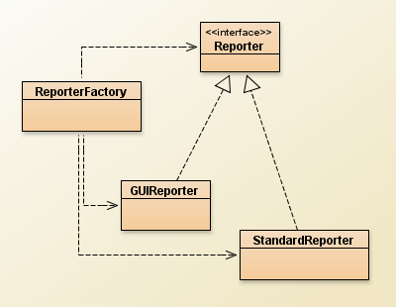
Example : Reporter continued
We could add more
Reporter Objects
For each we would
modify the factory
class

Slide 35
Exercise 4
Create a new project called Reporter
Add the interface and three classes to the project ( they are on Blackboard)
Next add the class ReporterExample
It has
public ReporterExample()
a constructor
public void selectReporter(int choice)
method to select Reporter type
public void printReport()
represents the application

Slide 36
Exercise 5
Create a ReporterExample object
invoke selectReporter with the parameter set to 1
invoke printReport
invoke selectReporter with the parameter set to 2
invoke printReport

Slide 37
Comparable<T> Interface
Part of the Java API
A class implements the Comparable interface when its objects can be arranged into a particular order.
For example, the class String implements Comparable, because strings can be arranged into alphabetical order.
Objects of a class that implements Comparable can be compared to each other to determine which comes first when the objects are arranged in order.
In the above, "T" stands for the type of the objects.
For example, if the objects are Strings, then "T" is String.

Slide 38
Comparable<T> Interface
The Comparable<T> interface consists of just one method (and no constants):
int compareTo( T obj )
// Compare this object with obj, which is of type T.
// Return a negative integer, zero, or a positive integer,
// when this object is less than, equal, or greater than obj.

Slide 39
Only the sign of the returned integer matters if the return value is not zero. The magnitude of a returned integer does not signify anything.
 | Relation |  | objectA.compareTo( objectB )
objectA | Less Than | objectB | Negative Integer
objectA | Equal | objectB | Zero
objectA | Greater Than | objectB | Positive Integer

Slide 40
Rules for compareTo()
If A.compareTo(B) > 0 then B.compareTo(A) < 0.
If A.compareTo(B) > 0 and
B.compareTo(C) > 0 then A.compareTo(C) > 0.
If A.compareTo(B) == 0 then
A.compareTo(Z) and B.compareTo(Z)
should give the same result, no matter what
Z is.

Slide 41
Question
Say that X.compareTo(Y)==0.
Is it then true that X.equals(Y)?

Slide 42
Example a compareTo()
Say that you are writing a computer game that involves a hero who encounters various monsters.
Monsters have several characteristics:
hit points,
strength
age
name.
The number of hit points a monster has is how far it is from death.
A monster with a large number of hit points is hard to kill.

Slide 43
Example
The hero also has hit points.
When the hit points of the hero reach zero, the game is over.
The strength of a monster affects how many hit points the hero loses when the monster hits the hero.
The age and name of the monster do not affect the outcome of battles between the monster and a hero.

Slide 44
Monster Class
Monster needs a compareTo() method so that monsters can be compared.
For example, the game will present the hero with monsters in increasing order of difficulty.
Typically, only some of the instance variables of a complex object are used by compareTo().
Say that you want monsters to be listed in ascending order of hit points.
Monsters with the same number of hit points are ordered by ascending strength

Slide 45
class Monster implements Comparable<Monster>
{
private int hitPoints, strength, age;
private String name;
public Monster( int hp, int str, int age, String nm )
{
hitPoints = hp;
strength = str;
this.age = age;
name = nm;
}

Slide 46
public int getHitPoints() { return hitPoints; }
public int getStrength() { return strength; }
public int getAge() { return age; }
public String getName() { return name; }
public String toString()
{
return "HP: " + getHitPoints() + " \tStr: " +
getStrength() + "\t" + getName();
}

Slide 47
public int compareTo( Monster other )
{
}
} // end class
Complete the method

Slide 48
Review
Inheritance can provide shared implementation.
Concrete and abstract classes.
Inheritance provides shared type information.
Classes and interfaces.

Slide 49
Review
Abstract methods allow static type checking without requiring implementation.
Abstract classes function as incomplete superclasses.
No instances.
Abstract classes support polymorphism.

Slide 50
Interfaces
Interfaces provide specification without implementation.
Interfaces are fully abstract.
Interfaces support polymorphism.
Java interfaces support multiple inheritance.

